Slide 1
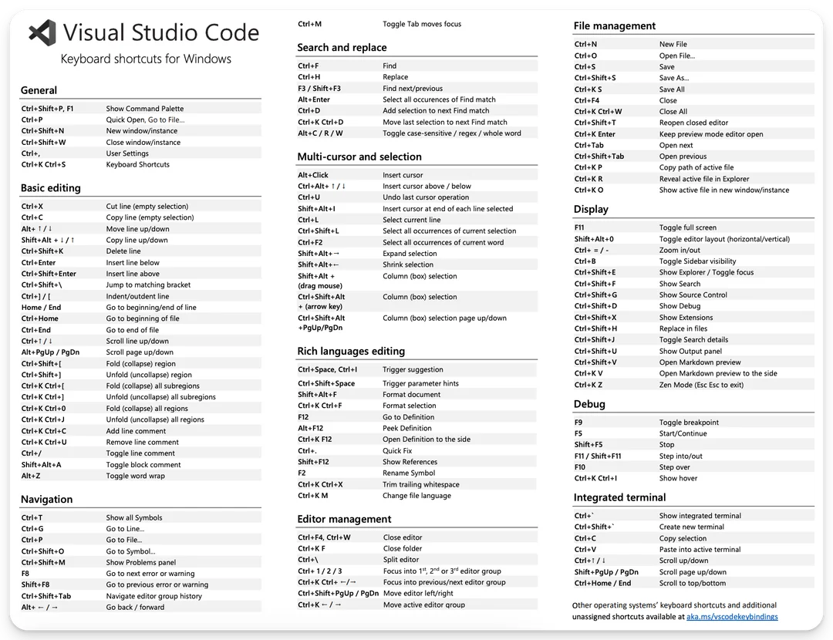


Slide 2

a1
a2
a3
a4
a5
a6
a7
a8
a9
Accent
Sat: 180;
Lum: 200;
b1
b2
b3
b4
b5
b6
b7
b8
b9
Bold
Sat: 220;
Lum: 180;
ID | R | G | B
a1 | 239 | 161 | 170
a2 | 239 | 180 | 161
a3 | 239 | 217 | 161
a4 | 239 | 235 | 161
a5 | 189 | 239 | 161
a6 | 161 | 222 | 239
a7 | 161 | 207 | 239
a8 | 161 | 180 | 239
a9 | 180 | 161 | 239
b1 | 245 | 115 | 130
b2 | 245 | 146 | 115
b3 | 245 | 208 | 115
b4 | 245 | 239 | 115
b5 | 161 | 245 | 115
b6 | 115 | 217 | 245
b7 | 115 | 192 | 245
b8 | 115 | 146 | 245
b9 | 146 | 115 | 245

Slide 3
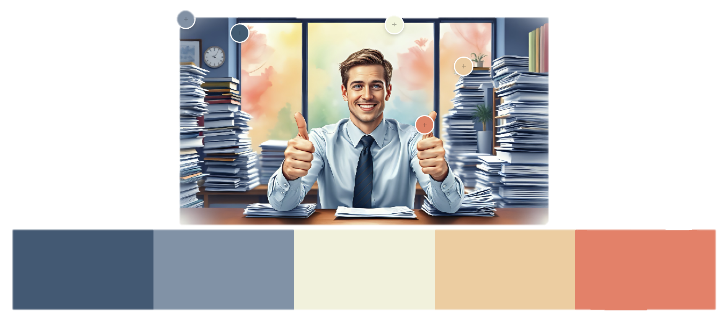
--bg-color
--hover-color
--color
--opposite-color
--primary-color
--secondary-color
--accent-color
--subtle-color
--soft-color

Slide 4


--bg-color
Unlimited Warrant Board Study Guide
Nate’s Edition!

Slide 5

UWB
UWB

Slide 6

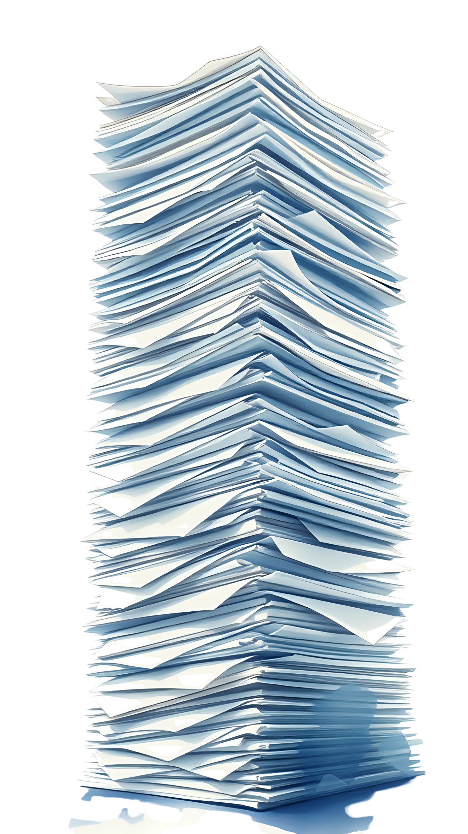
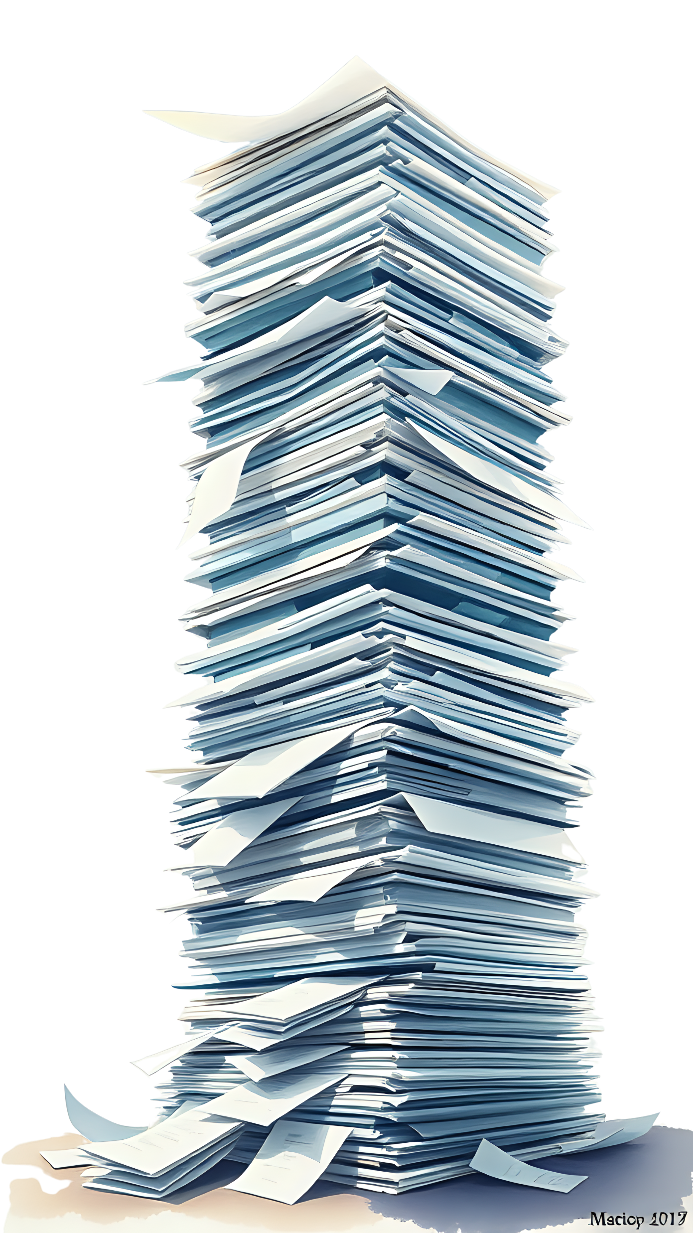
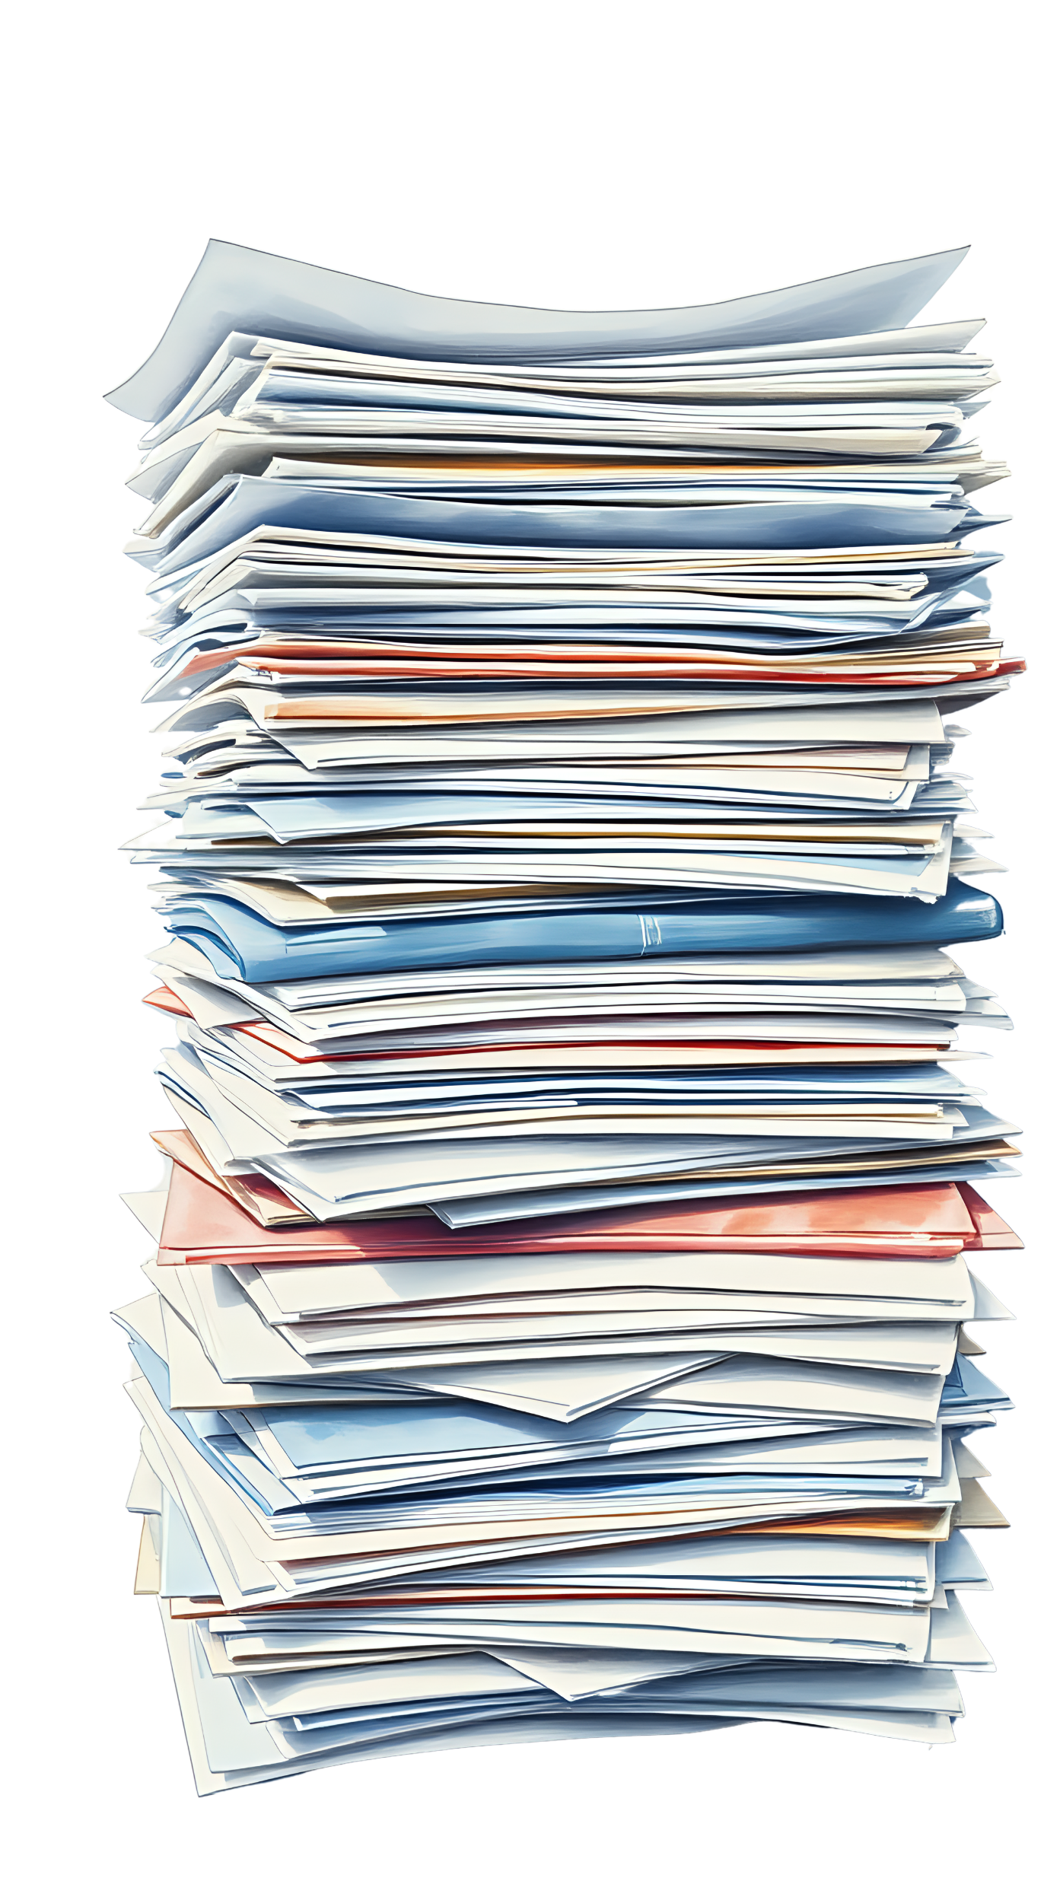

Slide 7
3741853056
Render FX Seed

Slide 8
UWB-SG
A realistic watercolor of a happy, comfortable thirty-year-old businessman with light-brown hair, blue eyes, and white skin giving two thumbs up while sitting at a desk filled with stacked papers. The office behind him is also filled with stacks of papers on virtually every surface. A large window filled with soft colorful watercolors in the background. Symmetrical. Deep colors.

Slide 9
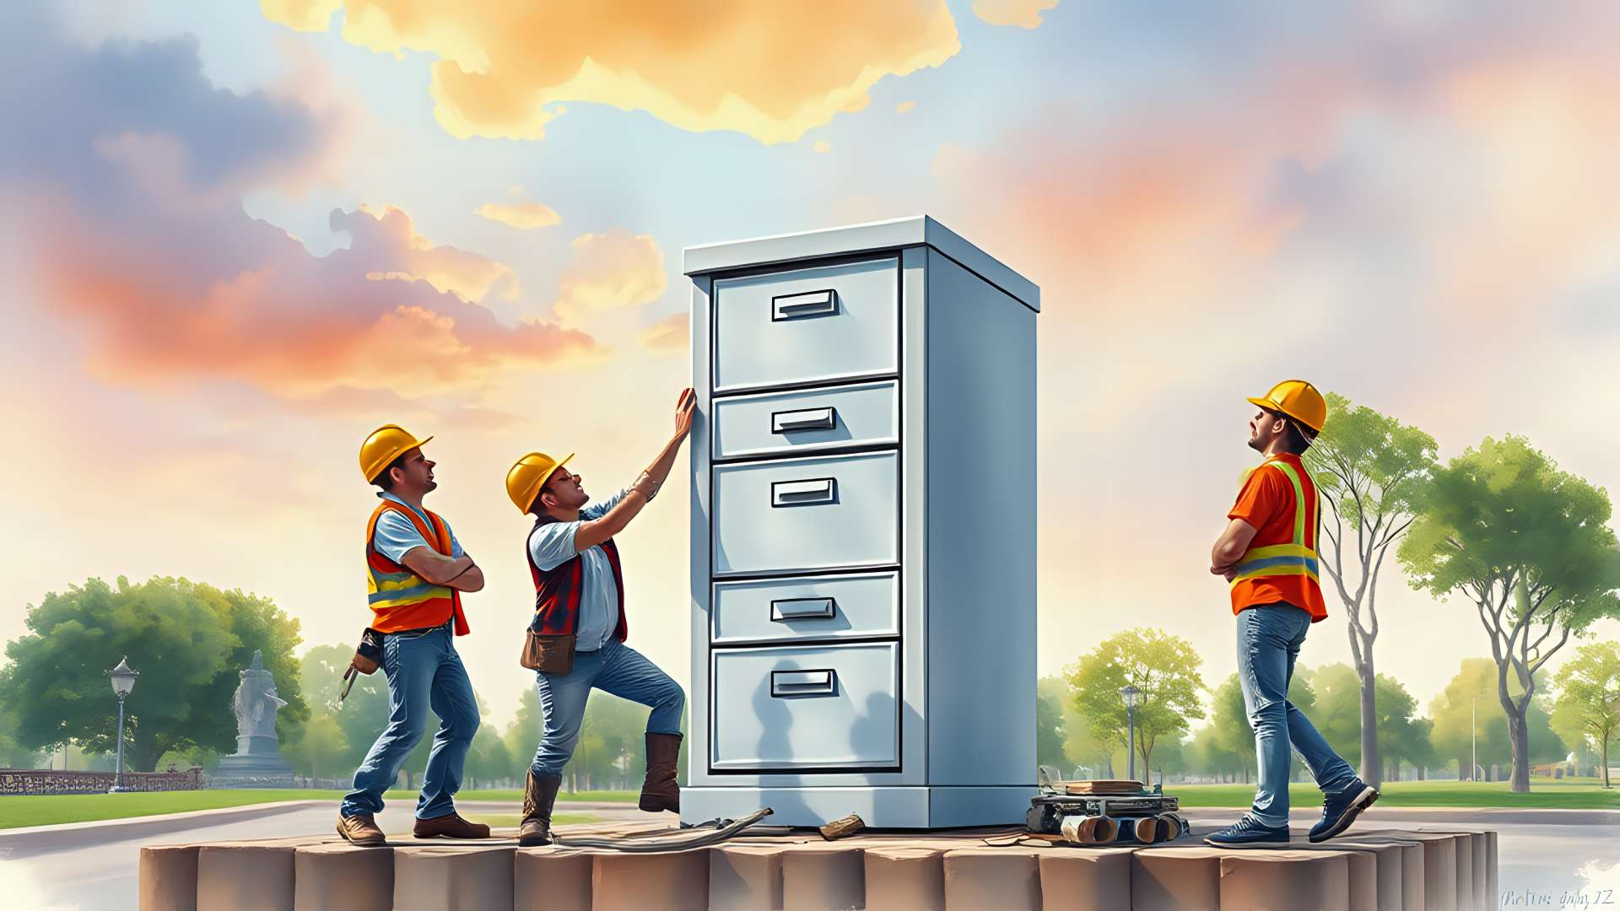
TODO
An ultra-realistic watercolor of a happy construction workers building a filing cabinet monument. The background has a beautiful park and the sky is filled with soft colorful watercolors in the background.
Under Construction

Slide 10

TODO
An ultra-realistic watercolor of a happy construction workers building a filing cabinet monument. The background has a beautiful park and the sky is filled with soft colorful watercolors in the background.
[Manually added the banner.]

Slide 11
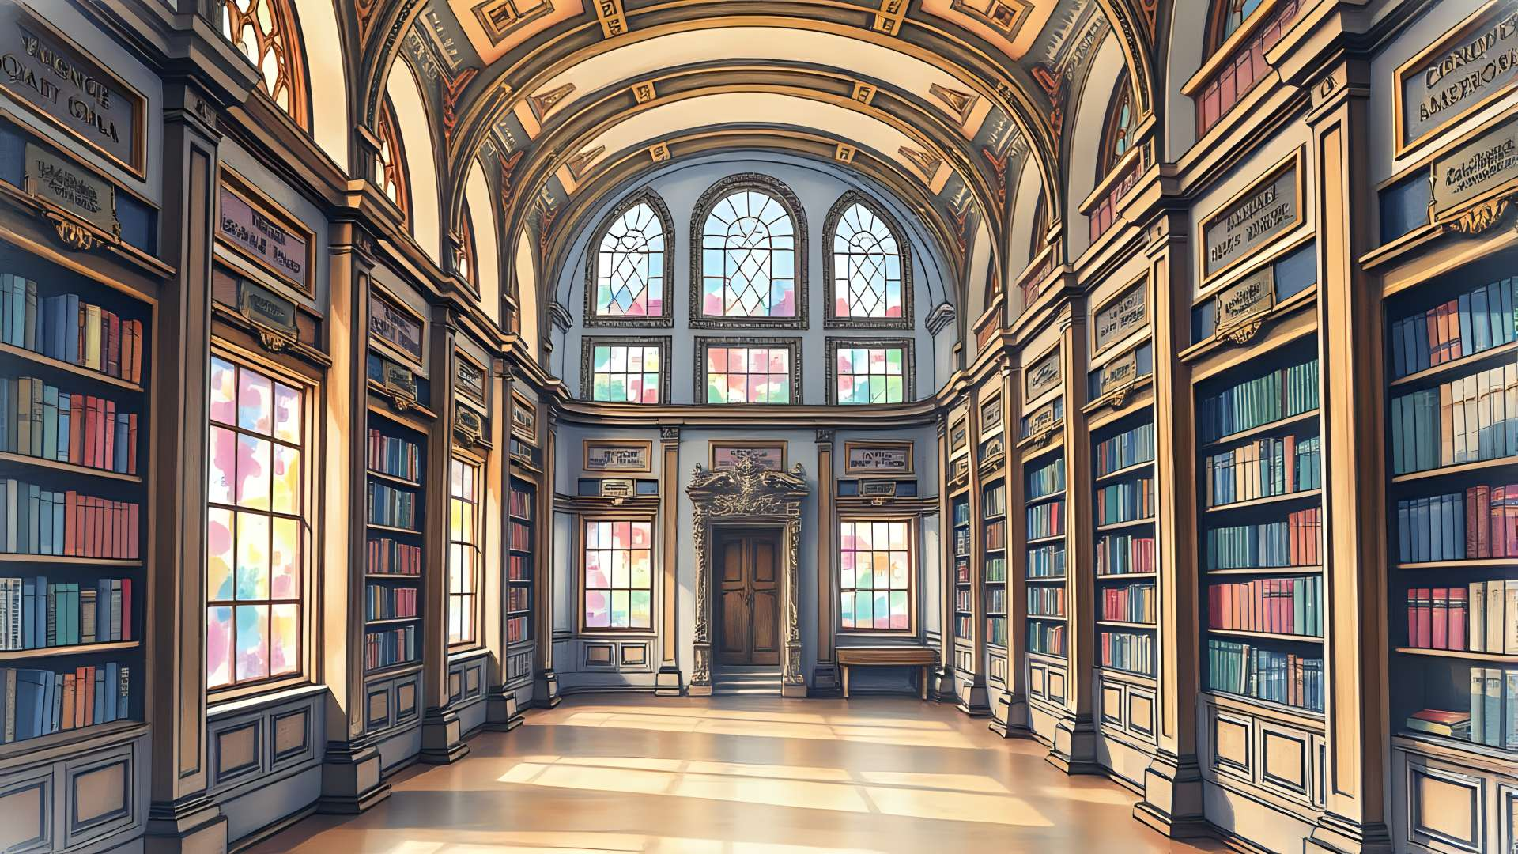
Far-toc
A semi-realistic watercolor of a classical library with ornate
plaques marking the rows and windows filled with abstract watercolors in the background. Symmetrical.

Slide 12
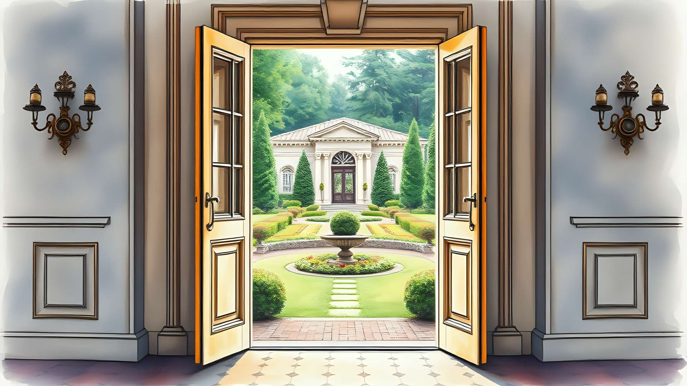
Thresholds
A semi-realistic watercolor of an open door marking the threshold to the classical garden outside with watercolors in the background. Ornate. Symmetrical.

Slide 13
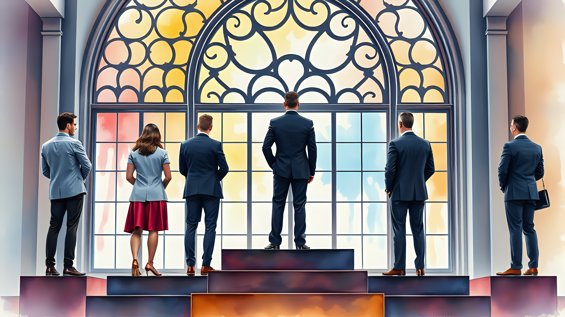
Key Personnel
Semi-realistic watercolor of five business people with their backs turned standing on various levels of a tiered-award-stand. A large ornate window filled with soft colorful watercolors in the background.

Slide 14
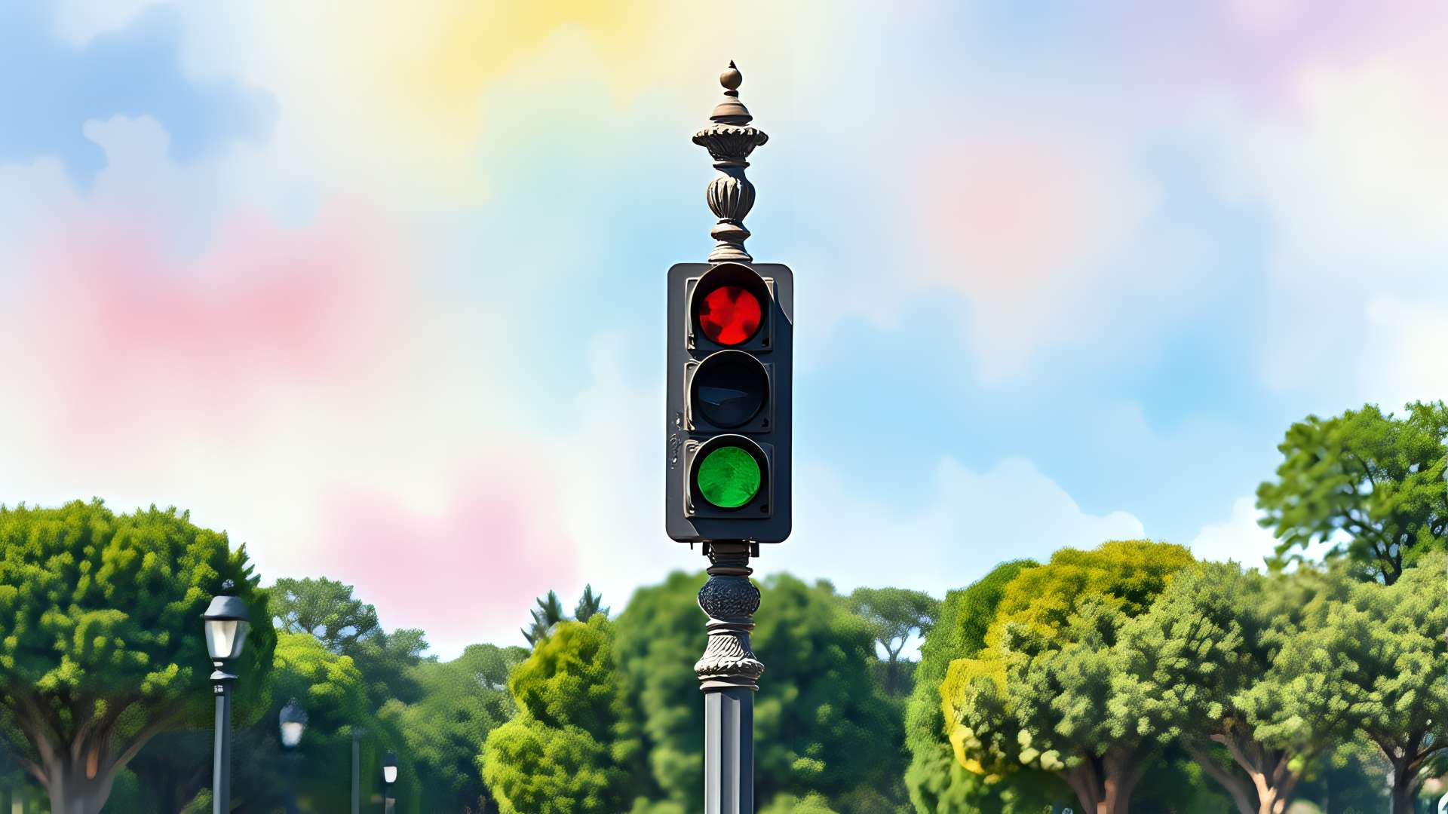
clearance
A watercolor of a pristine traffic signal on an ornate pole. Symmetrical. The background is a lush park, and the sky is filled with abstract colorful watercolors.

Slide 15
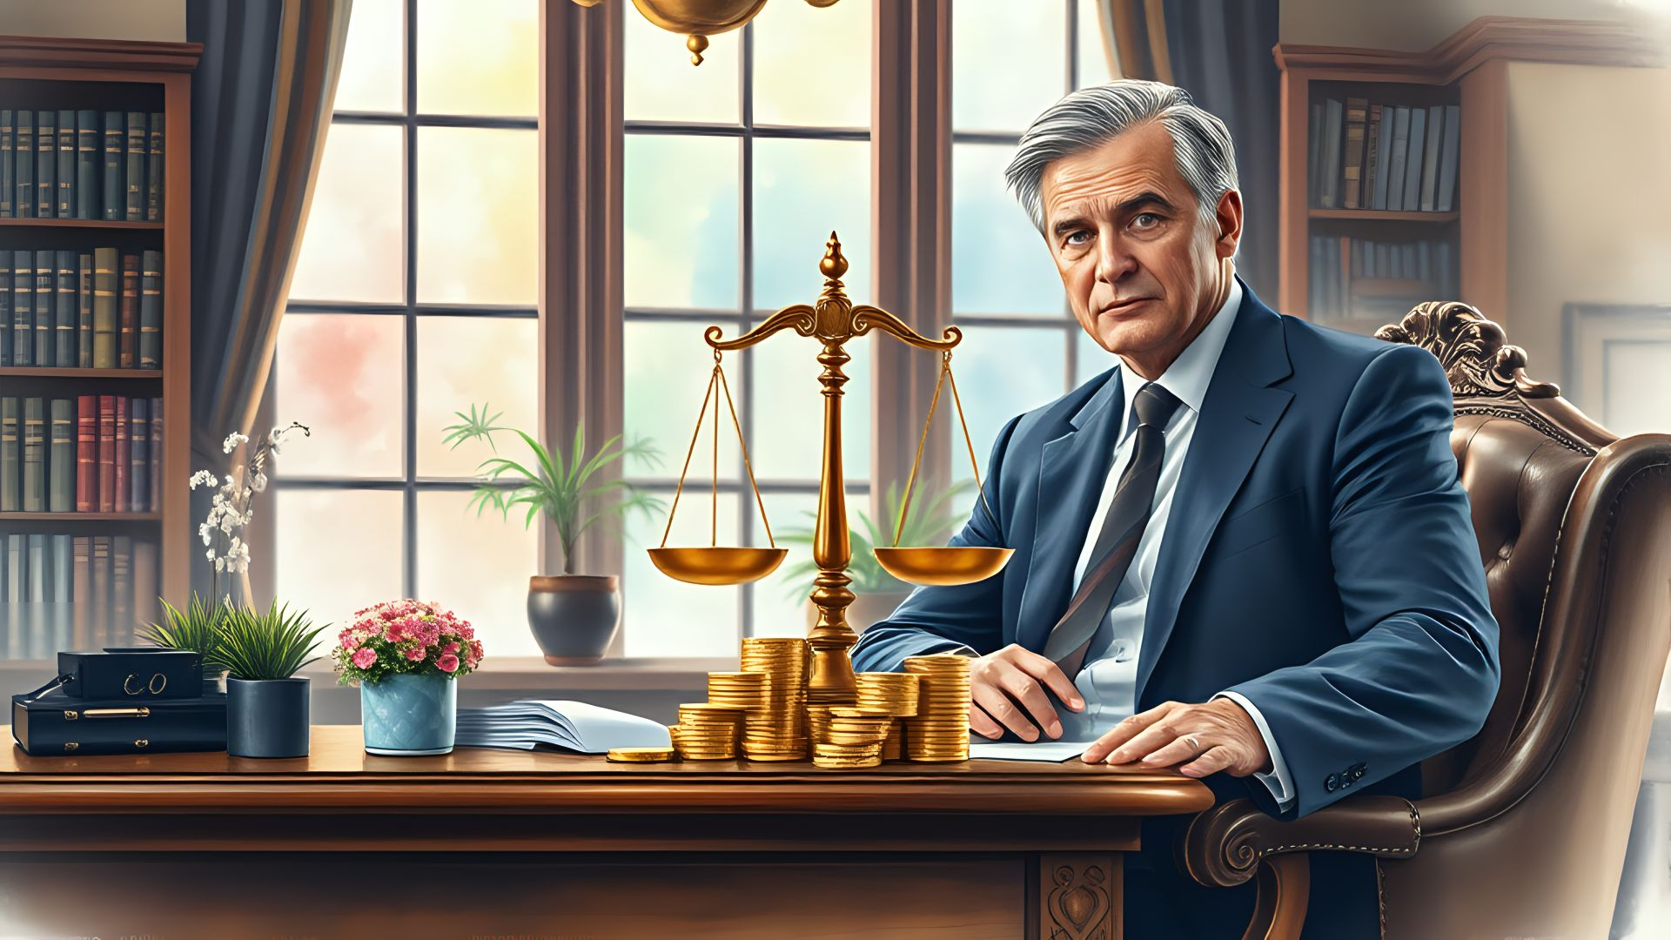
Fiscal Law
A semi-realistic watercolor of a stoic middle-aged lawyer comfortably sitting on the side of an ornate desk. Judicial scales in the center. Stacks of small gold coins. Potted plants. A large window with soft colorful watercolors in the background.

Slide 16
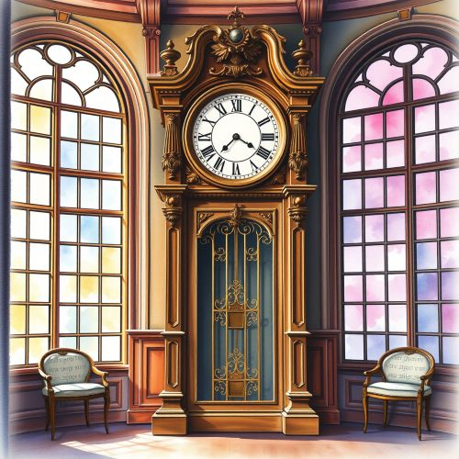
Time
A semi-realistic watercolor of an ornate grand clock forward in a library. Windows with soft colorful watercolors in the background. Decor. Centered. Cheerful and bright mood. Symmetrical.

Slide 17
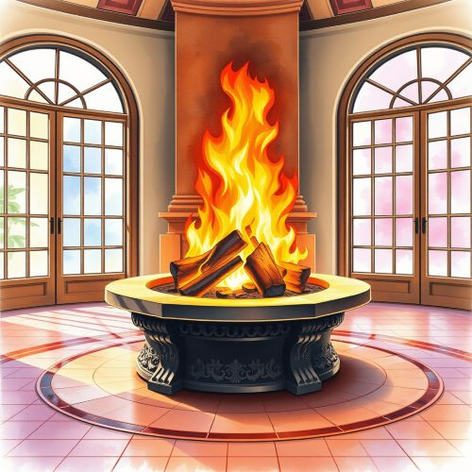
Purpose
A semi-realistic watercolor of a large fire burning with purpose. Ornate stone fire pit. Tile flooring. Grand windows showing soft colorful watercolors in the background. Decor. Centered. Cheerful and bright mood. Symmetrical.

Slide 18
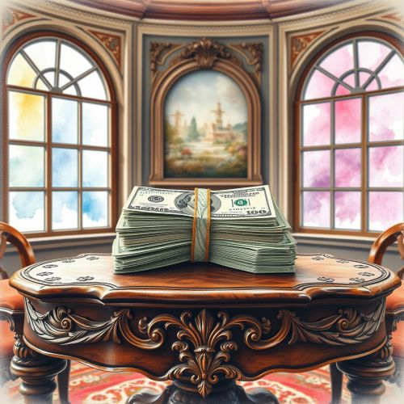
Amount
A semi-realistic watercolor of a bundle of dollars on an ornate wooden table. Windows with soft colorful watercolors in the background. Decor. Centered. Symmetrical.

Slide 19

Competition
An ultra-realistic watercolor of black business man competing with a Japanese business man in an ornate office with a window filled with watercolors in the background. Separated red boxing gloves. Faces close together. Symmetrical. Eye contact.

Slide 20
One Unusual Impalla
A realistic watercolor of an impala eating a catalog while stomping other products. Destroyed items and boxes. The background has a beautiful park and the sky is filled with soft colorful watercolors in the background.

Slide 21

Pricing
A semi-realistic watercolor of an older Asian business lady with glasses using a calculator. Ornate office setting. There is an ornate mirror in the background that is filled with soft cloudy colorful watercolors. Centered. Peral necklace. Vase of roses.

Slide 22

Source Selections
A realistic watercolor of a happy Hispanic businesswoman holding up a trophy. There are a group of sad business people behind her. Ornate windows with soft colorful watercolors in the background.

Slide 23

Legal Review
An ultra-realistic watercolor of a happy middle-aged black female lawyer with a document in hand while sitting behind an ornate desk. Large potted plants. Eye contact. Thumbs up. An ornate window with soft colorful watercolors in the background.

